Slide 1
E- Commerce Database System

Slide 2
Outline
Introduction?
Topic/Problem Statement?
SQL Query?
Explanation?
Relational Algebra?
Schema Diagram?

Slide 3
Introduction?
An E-commerce Database System streamlines online shopping by managing customers, products, orders, and payments, ensuring efficient inventory control, order tracking, and seamless transaction processing.

Slide 4
Topic/Problem Statement?
E-commerce
Database System
Online Shopping
Customers
Products
Orders
Payments
Order Processing
Inventory Management
Financial Transactions
These terms emphasize the core functionalities
and purpose of the system

Slide 5
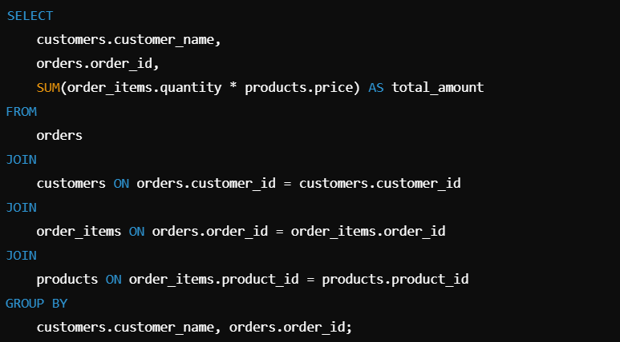
SQL Query?
This query retrieves the total amount spent by each customer on their orders:

Slide 6
Explanation
Tables Involved:
Customers: Stores customer details (e.g., customer_id, customer_name).
Products: Stores product details (e.g., product_id, product_name, price).
Orders: Captures order details (e.g., order_id, customer_id, order_date).
Order_Items: Links products and orders with quantity.
Query Breakdown:
Joins tables to combine relevant data.
Groups by customer_name and order_id to calculate the total amount spent per order
Uses the SUM function to calculate the total amount for each order based on product prices and quantities.

Slide 7
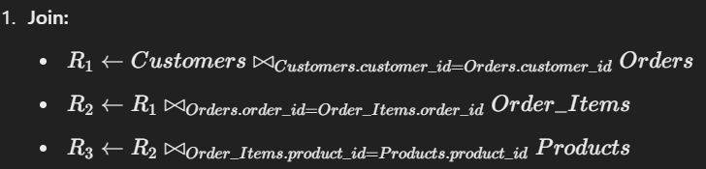
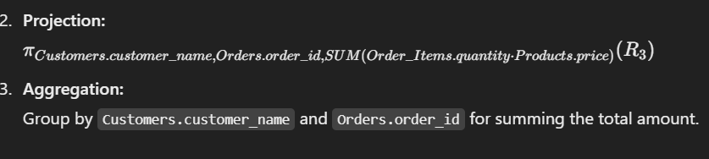
Relational Algebra

Slide 8
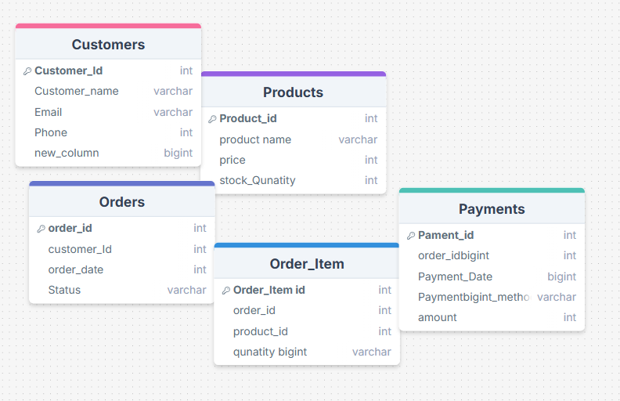
Schema Diagram

Slide 9
Conclusion
An e-commerce database system effectively stores and organizes customer, product, order, and payment information, ensuring seamless transactions, efficient inventory management, and improved user experience for both customers and businesses.

Slide 10
Questions & answers
Thank You
Promod Chandra Das
ID: 231002005

